Slide 1






RS232
Calibration
RS485
RS232
UART
RS485
BLE
PP1

Slide 2
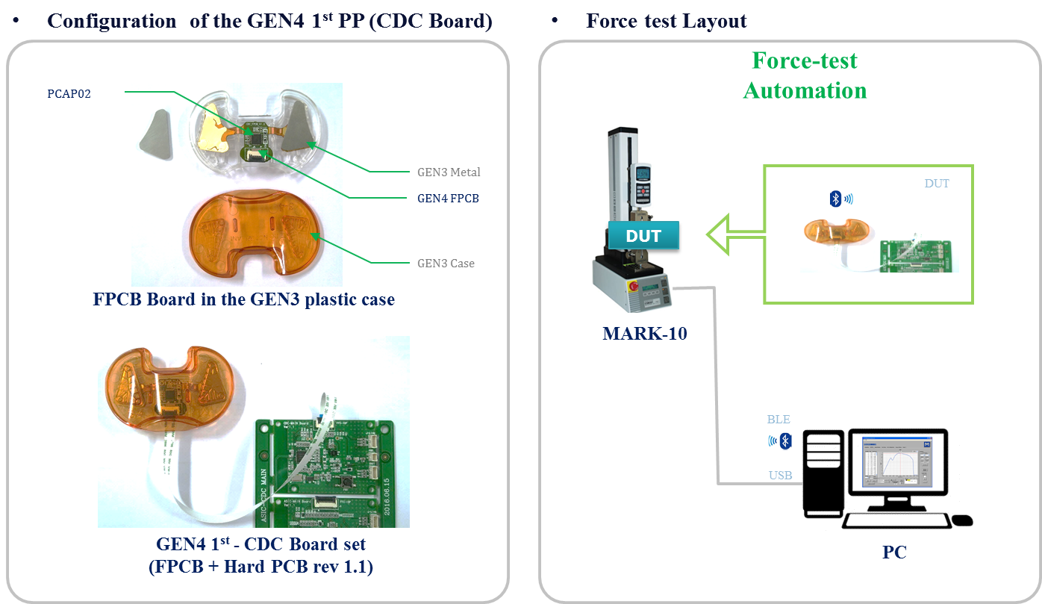
GEN4 1st PP – Development Setup

Slide 3
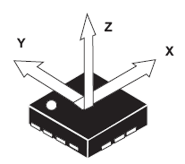
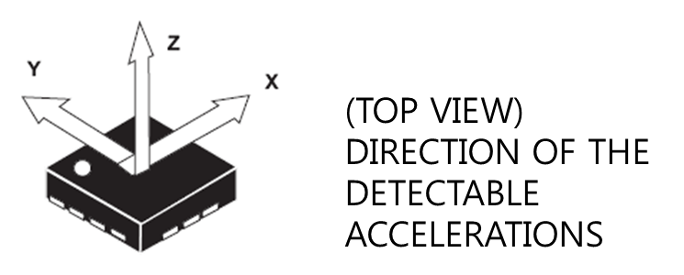
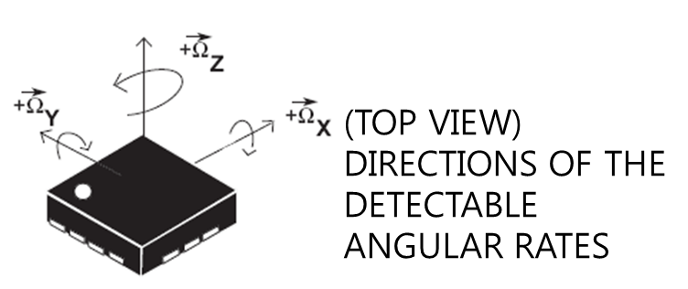
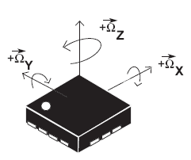
(TOP VIEW)
DIRECTION OF THE
DETECTABLE
ACCELERATIONS
(TOP VIEW)
DIRECTIONS OF THE
DETECTABLE
ANGULAR RATES

Slide 4


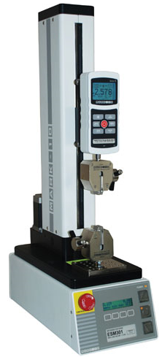
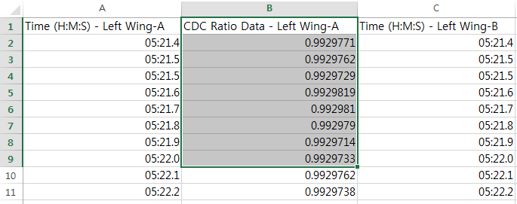
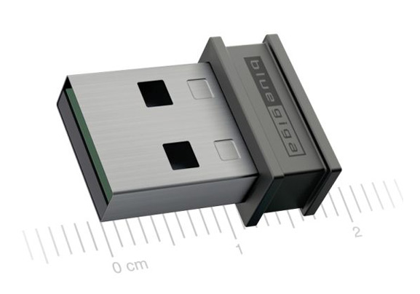
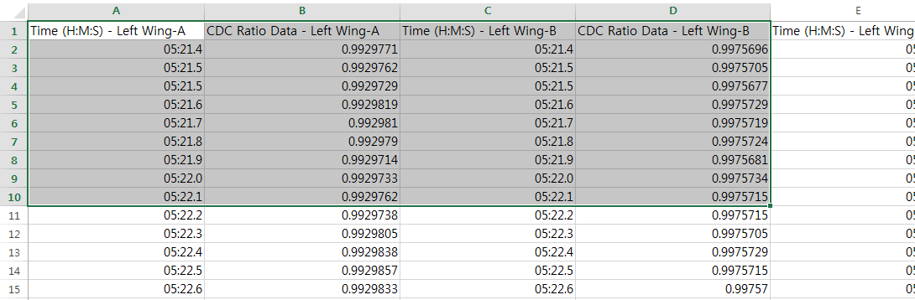




Slide 5
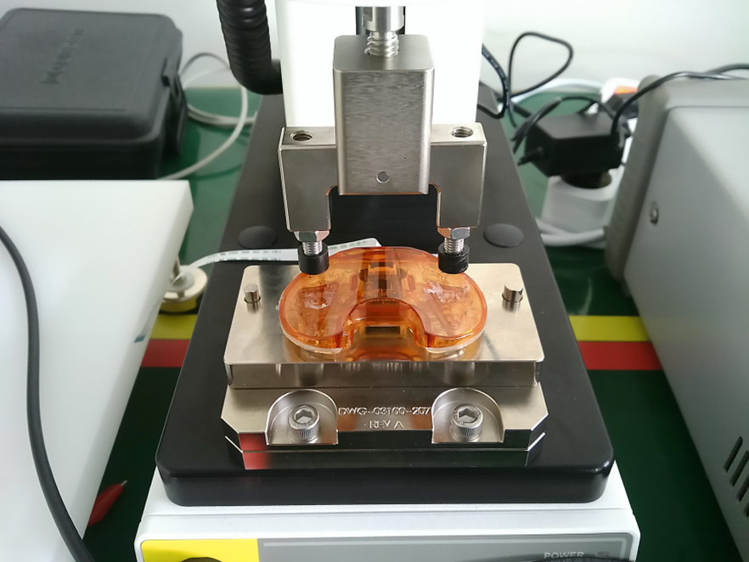
GEN4 – Development Setup
Mark10 Setup
- Serial>Data format>Numeric + Units

Slide 6
PP4

